Slide 1
Mantid a brief introduction
Toby Perring
20/05/2008

Slide 2
Why do we need Mantid?
Previously different tools were used on the different beamlines.
  PC Collette, Ariel, SXD2000, OpenGenie, LibISIS.
  Confusing for users.
  Replicated effort across the tools.
  Difficult to support.
Mantid
  To standardise data reduction tools between instruments.
  To improve the support and documentation for the tools.
  To handle the expansion of data volume.
  While having the flexibility to be extended by scientists as required.

Slide 3
What will Mantid do?
Mantid
  Manipulation and Analysis Toolkit for ISIS Data
Aims
  To provide a framework for Data Analysis that is not instrument or technique/dependent.
  To support multiple target platforms (Windows, Linux).
  The framework must be easily extensible by Instruments Scientists/Users.
  The framework must be freely redistributable to visiting scientists.
  The framework should provide low-level functionalities for Scripting, Visualization, Data transformation, Implementing Algorithms, Virtual Instrument Geometry.

Slide 4
Top Requirements
Easily extensible.
  Support all current and future analysis.
  Support current and future file formats.
  Provide a simple but powerful objects and services to support user created algorithm code.
No user license costs
  Developed under a GPL license
Supportable.
Portable.
  Operating System (Windows, Linux).
  Computing Power (Laptop, Server).

Slide 5
Architectural Design - Overview
Instrument log files
Command line & Scripting interface
Mantid Framework
RAW data files
API
Standard Algorithms
User Defined Algorithms
QTIPlot Graphing tool
NEXUS data files
Matlab Interface
Future Data analysis GUI

Slide 6
What Mantid can do now
Data Input
  Raw, Instrument Definition and Nexus files
Data Export
  Simple CSV and Nexus files
Internal Data Structures
  1D and 2D workspaces
Algorithms
  +, -, *, /, Integration, Rebinning, Unit Conversion, etc
Instrument Definition
  Sufficient definition to allow conversion of units

Slide 7
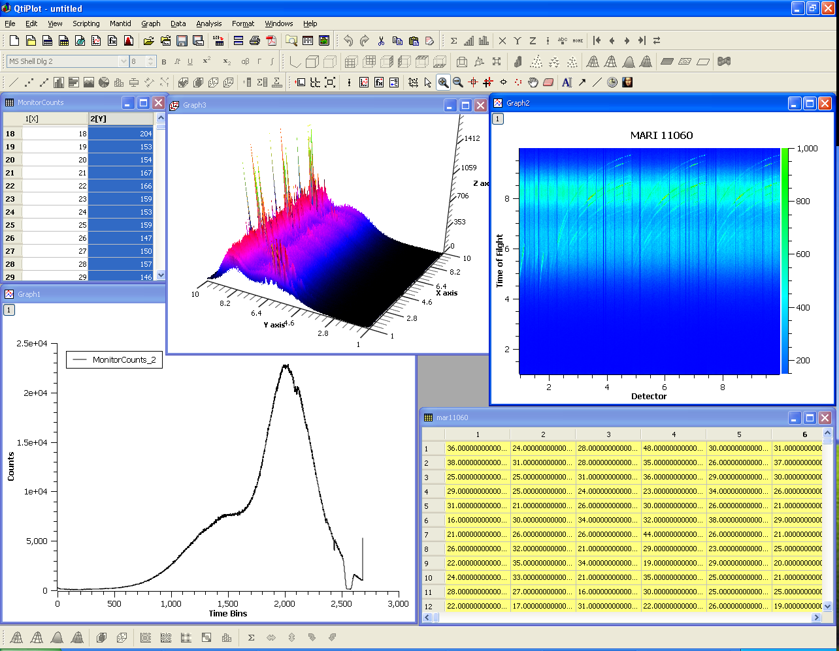
QTIPLOT Visualisation Interface

Slide 8
Command line/Scripting interface
The Python scripting language forms the command line and scripting interface of Mantid
  Access to the Mantid API through a Boost.Python callable wrapper.
  Also possible to extend Mantid classes in Python
    e.g. Writing new algorithms in Python
  Interactive mode in python gives command line like access with immediate execution
  Available in QTIPlot interface as well as standalone.

Slide 9
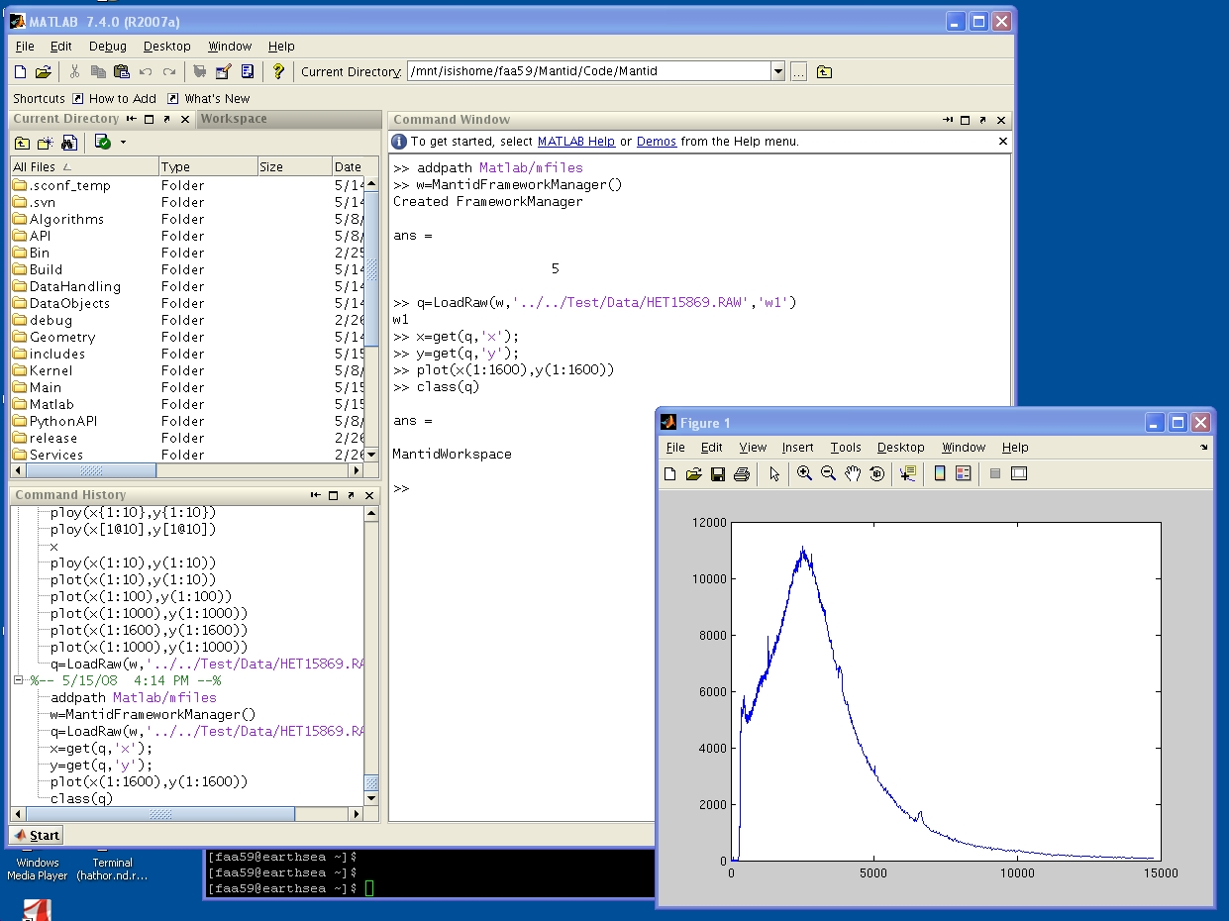
Matlab Interface

Slide 10
Further Information
Project Web Page
  www.mantidproject.org
Project Introduction Document
  http://svn.mantidproject.org/mantid/trunk/Documents/Requirements/Project%20Introduction%20Document.doc
User Requirements Document
  http://svn.mantidproject.org/mantid/trunk/Documents/Requirements/URD.doc
Architectural Design Document
  http://svn.mantidproject.org/mantid/trunk/Documents/Design/Architecture%20Design%20Document.doc

